Slide 1
RFID / NFC
Week 5

Slide 2
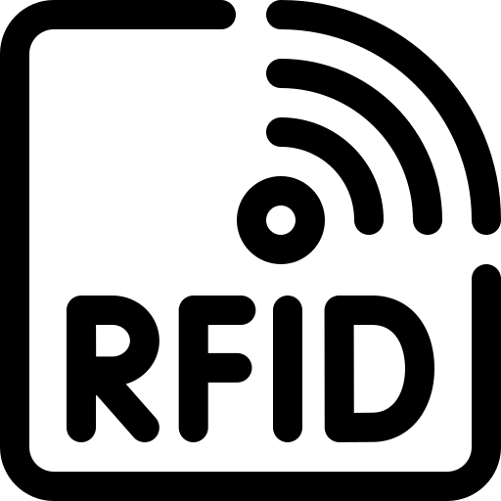
What is RFID?
Radio Frequency Identification (RFID) is a technology that uses radio waves to identify people or objects.
There is a device that reads information contained in a wireless device or “tag” from a short or long range without making any physical contact or requiring a line of sight.
The two primary types of RFID are Passive and Active RFID.

Slide 3
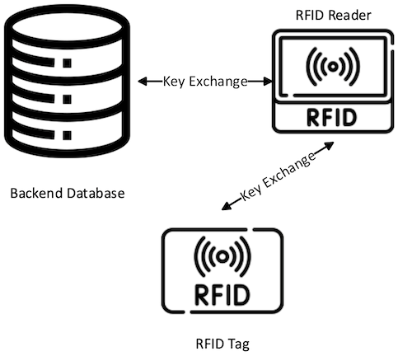

RFID (Visualized)

Slide 4
Active RFID
Broadcasts a unique radio identifier code. They come in both transponder and beacon variants.
A transponder version listens for a request from an RFID reader and transmits only when prompted.
A beacon variant continuously sends a signal. As a result, the transponder version has a long battery life.
Both transponder and beacon active RFID tags often communicate in the 433 MHz and 2.45 GHz radio ranges.
The most common use of Active RFID are Interstate Toll Transponders.

Slide 5
Passive RFID
Consists of an antenna connected to an integrated circuit.
Transmits a unique radio signal to the passive tag, and the signal gives power to the RFID tag. The lack of power source reduces the cost and complexity compared to active RFID tags.
Can be incorporated into stickers, cards and other small form factors and mass-produced at low cost.
They support ranges of 125-134 KHz for a few inches, 13.56 MHz for a few feet, and 865-960 MHz for tens of feet.
The most common use of Passive RFID can be found in Hotel Key Cards, Key Fobs, Our Champlain College ID’s, etc. These are typically “125KHz RFID.”

Slide 6
What is NFC?
Near Field Communication (NFC) tags work like any other RFID tag to communicate over radio waves. The two devices — the NFC tag and the NFC reader exchange information in NFC data exchange format.
An NFC tag sends radio waves to activate the antenna in a receiving device. The recipient validates the information to complete information exchange.
The technology works over a very short distance (approximately 4 inches). It operates on the 13.56MHz frequency range. NFC tags work without a battery and draw power from another device, (like a smartphone.)

Slide 7
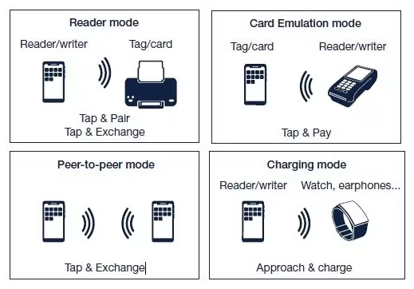
NFC (Visualized)

Slide 8
This Weeks Lab
We will be making our own NFC Tags! Follow along with the lab to get started!
You can use any iPhone above an iPhone 7 (iOS 13+), a supported Android phone (there are too many to list), or a Flipper Zero.
Your best bet for iPhone and Android devices is to use “NFC Tools.”

